Slide 1
Figures for PTS paper
2/23/2017

Slide 2
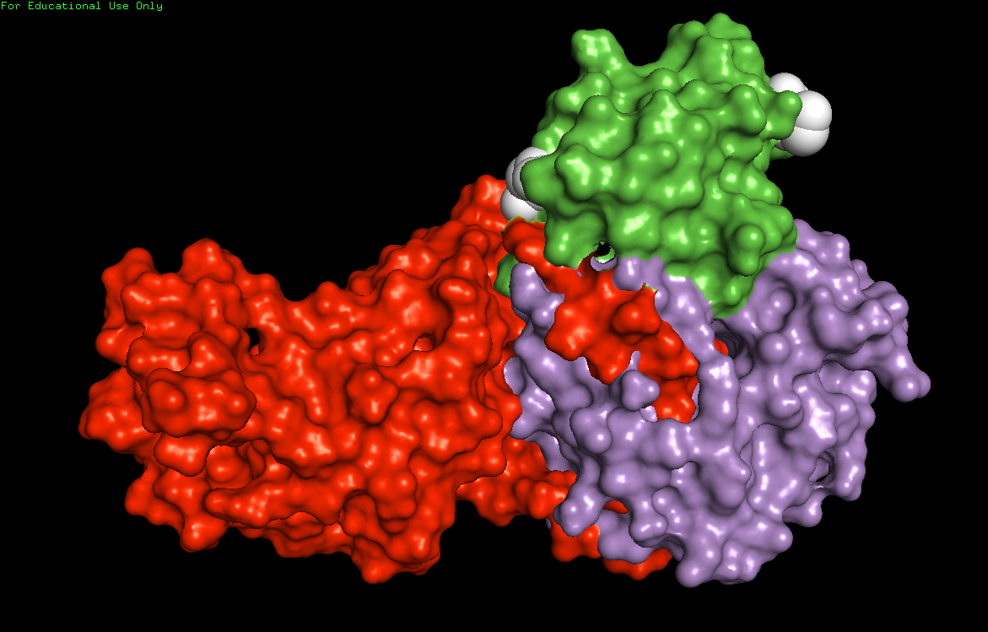
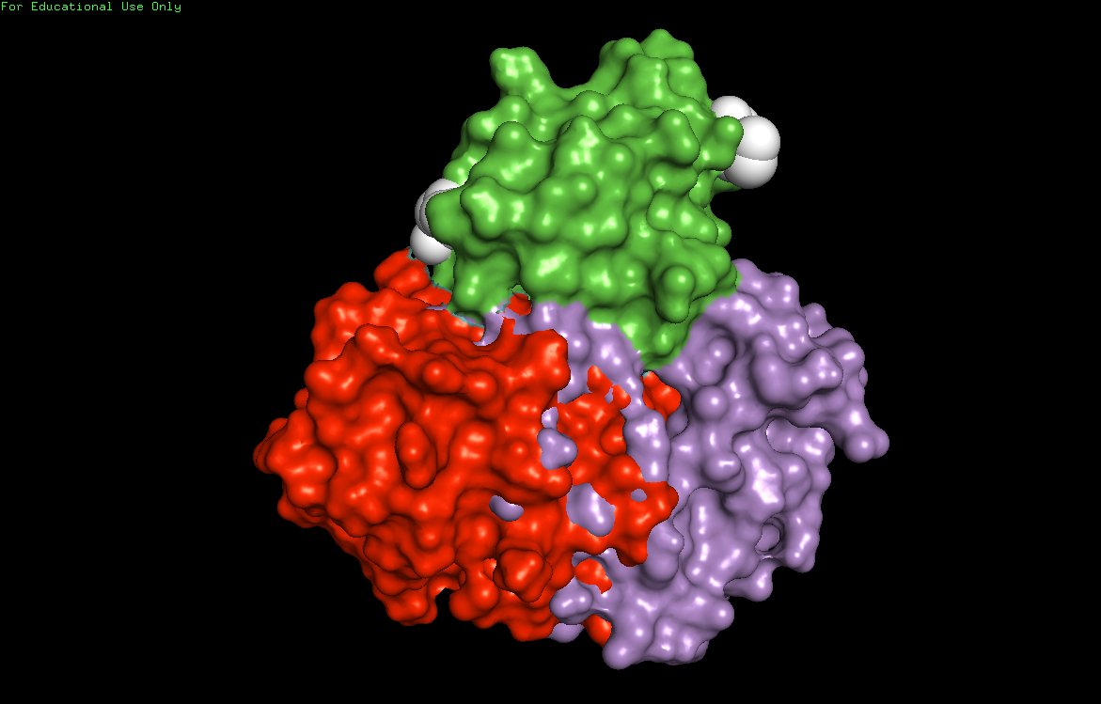
Hpr in complex with members of the PTS pathway
Green: E. coli Hpr (docked)
Purple: E. coli PykN (docked)
White: N-terminus (right) and C-terminus (left) of E. coli Hpr
Green: E. coli Hpr (docked)
Purple: E. coli PykN (docked)
White: N-terminus (right) and C-terminus (left) of E. coli Hpr
Red: E. coli EIN (enzyme 1, N-terminal domain)
Red: E. coli EIIA^{MTL} (enzyme 2A, mannitol)

